Slide 1


LASER CLEANING OF SMALL PARTICLES
N. Arnold
Angewandte Physik, Johannes - Kepler - Universität
A-4040, Linz, Austria

Slide 2
Summary:
Principle of dry laser cleaning
Adhesion potential and cleaning force
Thermal expansion
3 cleaning regimes
Resonance effects
Focusing, 3D heating and expansion
Local ablation
Steam laser cleaning
Influence of humidity
Cleaning with laser-induced SAW
Influence of storage time

Slide 3
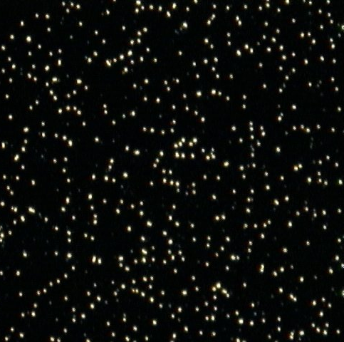
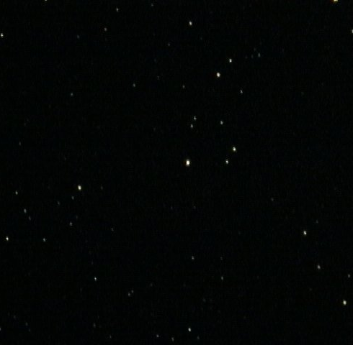
Principle of dry laser cleaning¹
short
laser
pulse
Before
After
Fast thermal expansion
¹W. Zapka, A. Tam, Appl. Phys. Lett., 91
Notes:
Real particles are non-spherical, but spherical particles are often used for controllable and reproducible experiments, that allow quantification.

Slide 4
BACKGROUND:
Removal of inorganic and organic particulates from solid surfaces (microelectronics, micromechanics, sensor/ actuator technology, optics... )
MODEL SYSTEMS:
Mainly spherical particulates (metals, semiconductors, insulators, polymers) on solid surfaces

Slide 5
Motivation and goals
Killer defects below 100 nm
Traditional cleaning methods are complex
Clean smaller particles with alternative methods
Dynamic effects in the detachment of particles
Unified approach and compact formulas

Slide 6
- In all cases strong dependence on fluence and particle size
- Threshold for cleaning, φ_{Cl}
- φ_{Cl} increases with decreasing particle size r
- Strong influence of atmosphere

Slide 7
DEPENDENCE ON FLUENCE AND PARTICLE SIZE
Substrate absorption
Particle absorption
RH ≈
27 %
RH ≈
27 %
T.Fourrier, G.Schrems, T.Mühlberger, J.Heitz, N.Arnold, D.Bäuerle, M.Mosbacher, J.Boneberg, P.Leiderer: Appl.Phys.A 72, 1 (2001)

Slide 8
K_{c} = 2πσr ×
(cos ϕ₁ + cos ϕ₂ )
U = contact pot.
difference
Point cont. F ≈ π a r
Particle removal requires K_{cl}  K_{ad}

Slide 9
Adhesion potential
Force measurements - static
Laser cleaning – dynamic¹⁻⁶ ⇒ potential is important
VYu²
Potential⁷
h
- <Young modulus>
ϕ - work of adhesion
-Sϕ
¹Y. F. Lu et al., Appl. Phys. A, 99
²G. Vereecke et al., J. Appl. Phys., 99
³V. Dobler et al., Appl. Phys. A, 99
⁴D. Bäuerle, Laser Processing and Chemistry, 00
⁵V. Veiko et al., SPIE, 00
⁶B. Luk’yanchuk et al., Proc. SPIE, 01
⁷N. Arnold et al., Proc. SPIE, 01
This potential is a smooth function
Notes:
There exist more complicated descriptions of adhesion, for example DMT and JKR. The main parameter there is Muller parameter. It is y/h₀, where y is the distance from the surface where VdW pressure equates tensile stress: Yy/a~ϕ/ε. Here a is contact radius and ε range of action of VdW forces (about interatomic distance). All estimations neglect y in the first order. DMT is Muller<<1, hard spheres (F=2πϕr), and JKR is Muller>>1, soft spheres (F=3/2πϕr) with this hysteresis
Note that in some notations if not the work of adhesion but energy of a single surface is used for ϕ, the result is doubled.
Elasticity from Hertz contact problem. It is derived in general for 2 spheres with reduced radius. Both substrate and sphere are deformed and softer material is deformed stronger. Elastic energy is also stored in softer material with smaller Y. It all can pretty well be understood thinking in terms of 2 springs with different spring constants.
In reality area is different, but interaction energy extends, further, there exists a hysteresis, like in AFM tip-substrate interaction.
The key is that equations of 3D elasticity include Laplacian. It decays like 1/r. Therefore the volume is about a³ and strain h/a. This is enough to derive the qualitative behavior. Show it

Slide 10
Characteristics of adhesion potential
F₀
ω₀
U₀
h₀
Notes:
Orders of magnitude (for r~1 µm)
F~0.04 dyn=4×10⁻⁷ N=400 nN
U₀~ 10⁻⁹ erg= 10⁻² J
h₀~ 3×10⁻⁸ cm= 0.3 nm
a~ 3×10⁻⁶ cm= 30 nm
m~ 10⁻¹¹ g
For macroscopic spheres, say 1 cm, all laws are different, as gravity starts to play an important role, when mg>F₀. This is with r>1 mm

Slide 11
Equation of motion for h
Deformation h depends on the expansion of
substrate l and particle r
Laboratory displacement of the particle center z
Adhesion cleaning
+elasticity
z
r
h
l
Particle and
substrate expansion
enter together
Notes:
Some other terms like γdl/dt, γdr/dt, are usually of smaller order, unless damping is too strong.
Expansion of the substrate can be readily interpreted as force of inertia in non-inertial system moving with the surface.

Slide 12
Damping
Viscosity
Big particles, liquids, Stokes
η dynamic viscosity
Knudsen viscosity
r smaller than mean free path
m_{a} mass of gas molecules
N number density
Absorption of sound
Sound generated by thermal
expansion may be damped.
d - length
ν kinematic viscosity, D thermal diffusivity,
c -specific heat
Emission of sound
probably the strongest

Slide 13
Thermal expansion l(t)
substrate

Slide 14
laser
v₀τ<l_{α}+l_{T}<w; 1D l, sound, 1D T
w
weak absorbers
ps pulses
v₀τ
l_{α} +l_{T}
l
l_{α}+l_{T} <v₀τ<w; 1D l, 1D T
Valid for T-dependent parameters
ns pulses
l_{α}+l_{T}<w<v₀τ; 1D l (3D relaxation!), 1D T
Not a limit of 1D
Does not exist for stationary T
µs pulses, tight focusing
w<l_{T}< v₀τ; 3D l, 3D T
I(r), D dependent, transient
local 3D focusing, µs-ms pulses
Notes:
The meaning of the sound expression is clear – information about the expansion of subsurface layers does not reach the surface faster than the sound velocity.
The second 1D expression can be written in terms of fluence of intensity only due to Grüneisen proportionality between the thermal expansion and specific heat

Slide 15
laser
v₀τ<l_{α}+l_{T}<w; 1D l, sound, 1D T
w
weak absorbers
ps pulses
v₀τ
l_{α} +l_{T}
l
l_{α}+l_{T} <v₀τ<w; 1D l, 1D T
Valid for T-dependent parameters
ns pulses
l_{α}+l_{T}<w<v₀τ; 1D l (3D relaxation!), 1D T
Not a limit of 1D
Does not exist for stationary T
µs pulses, tight focusing
Difference
between approximations
can be significant
w<l_{T}< v₀τ; 3D l, 3D T
I(r), D dependent, transient
local 3D focusing, µs-ms pulses
Notes:
There can be different situations when this or that particular situation is relevant.
Besides, there can in principle be sound related effects, SAW, etc.

Slide 16
Typical 1D surface displacement
Notes:
What one has to remember, is that in 1D case velocity is intensity. Accelerations are about 10⁶g. Two orders of magnitude more (?) may lead to destruction of material.

Slide 17

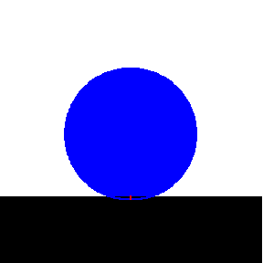
Particle expansion Δr
Enters equations exactly as substrate expansion
Absorbing particle
(no thermal contact)
Transparent particle
(ideal thermal contact)
structures of expressions are always the same
Notes:
Here several assumptions about equilibration of temperature and irrelevance of sound have been used, so this is all not for ps pulses. But for ns it is OK.
Particle substrate heat exchange is difficult, especially if we take into account that contact radius changes, etc.

Slide 18
Cleaning threshold
3 Regimes exist
Elastic energy
Force or inertia
Kinetic energy

Slide 19
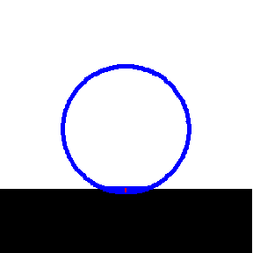
Short pulse, big particle
particle doesn't move ⇒
elastic energy
removal
Expansion →
compression →
(elastic energy) →
lift off after the pulse
Notes:
Note that it does not depend on τ, because the pulse is instantaneous for such a heavy particle.
Note also the increasing dependence on r, as h0 increases in this way with r.
The potential is not completely symmetric, so that there are some additional numerical pre-factors here.

Slide 20
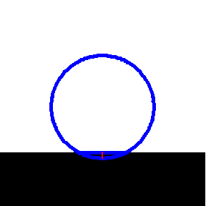
Long pulse, small particle
weak oscillations move ⇒
force (inertial)
removal (also for damping)
Expansion→
acceleration→
deceleration/particle inertia→
lift off due to decreasing I(t)
Notes:
Note very strong dependence on τ (as it influences acceleration), and very bad dependence on r, which is due to competition between the volume forces r³ and adhesive forces r
In reality there are some coefficients dependent on pulse shape and also small excitation of oscillations introduces some numerical factor, that is difficult (and useless) to calculate.
The functional dependences are the most important

Slide 21
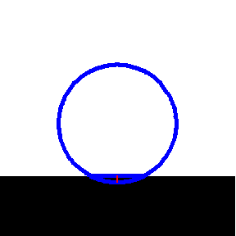
Long pulse, small particle
short pulse fronts , velocity transfer ⇒
kinetic energy
removal
Velocity is important
Fast stop→velocity→
particle inertia→
lift off due to velocity
after the pulse
Notes:
We saw on the previous slide that the faster is deceleration, the better. The extreme case would be an instantaneous stopping of the substrate. In this case the particle acquires instantaneous velocity, and detachment criterion is written in terms of kinetic energy rather than force.
Note more advantageous r and τ dependences.
Sound related effects set an ultimate limit to the rate with which the substrate can accelerate/decelerate.
It lies in the range of l_{T} or l_{α}/v_{s}~ 5×10⁻⁵/5×10⁵~100 ps for strong absorbers at least.
Leading front has less problems, as it is determined by l_{α}, while trailing front should “collect information” over the l_{T} depth.

Slide 22
3 CLEANING REGIMES
Excimer pulse
Second part, t_{f}=100 ps
Damping increases φ_{cl}, but keeps dependences
Notes:
One can see here the 3 regimes discussed above.

Slide 23
Pulse duration and material parameters
Excimer pulse
10 times shorter pulse
10 times lower adhesion
3 times softer materials
Notes:
Pulse duration does not affect elastic regime
Young modulus does not affect force regime as pull-out force does not depend on elasticity, but on work of adhesion only.

Slide 24
Comparison with experiments
N. Arnold et al., Proc. SPIE, 2001
Notes:
It is important to realize, that the fluence cannot be made infinitely large as substrate damage starts. Homogeneous melting threshold is shown.
In reality local damage may start even earlier due to local field enhancement effects, that we will discuss later.

Slide 25
RESONANT LASER CLEANING (RLC)
10 sinusoidal pulses, 100 MHz, no damping
Damping γ=0.2ω₀
Damping γ=0.5ω₀
Notes:
In order to avoid damage, one can try to excite adhesion frequency resonantly. As intensity is velocity, it is enough to modulate the pulses.
Too many pulses is useless as damping and non-linearity of potential will prevent to use resonant effects in full.
Duration of each of 10 pulses is 10 ns, total duration is 100 ns. For the thermal problem at such a time scale it acts like single pulse with average intensity.

Slide 26
Local 3D effects
Local intensity distribution
3D thermal expansion
Ablation, vaporization
Notes:
Particle substrate heat exchange is difficult, especially if we take into account that contact radius changes, etc.

Slide 27

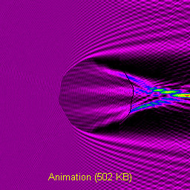
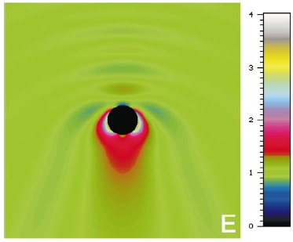
Local intensity distribution
Exact -- numerical¹, Mie^{2,3}, Mie + substrate^{4,5}
page
movie
³Luk'yanchuk et al., Proc. SPIE, 01
⁴Luk'yanchuk et al., Proc. SPIE, 00
⁵Münzer et al., Proc. SPIE, 02
¹Rohrbach et al., J. Opt. Soc. Am. A, 98
²Münzer et al., Journal of Microscopy, 01
Large particle – geometrical optics. Small particle – dipole+plane wave
Advantages:
simple
holds for non-spherical shapes
Disadvantages:
fine effects are lost, but:
ns heat diffusion smoothens
intensity

Slide 28
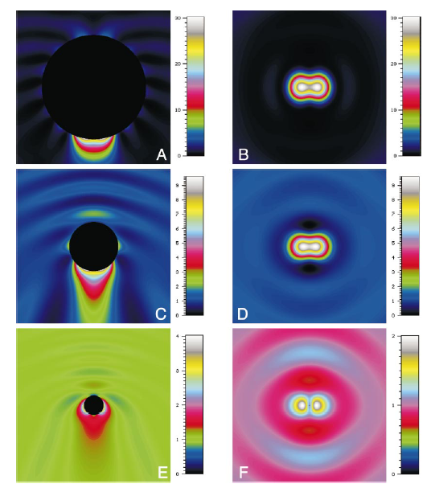
Mie calculations without substrate
(A,C,E)
(B,D,F)
E
A, B : 2r = 1.7 µm
C, D: 2r = 0.8 µm
E, F: 2r = 0.32 µm
The plot shows the intensity
I ∝ E²
y
k
E, x
2.5 µm
H.-J. Münzer, A. Pack et al.: Journal of Microscopy 202 , 129 (2001)

Slide 29
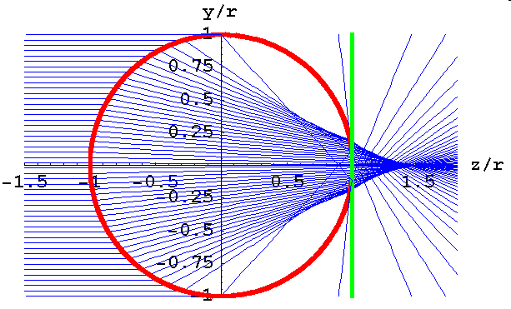
Large particle -- geometrical optics
I₀
I_{m}
Transparent particle
Absorbing substrate
We need surface I_{m}
Caustic
r>>λ; n=1.5
spot w_{g}∝ r
intensity I_{m}/I₀ - independent on r, unlike in focus
Holds for deformed particles

Slide 30
Small particle -- dipole
r=0.2λ; n=1.5; E_{x}-polariz.
spot w_{d} ≈r
spot w_{d}∝ r
additional 3D intensity I_{m}/I₀ ∝ r²
Holds also for non-spherical particles
Fine details are lost, no substrate
3D

Slide 31
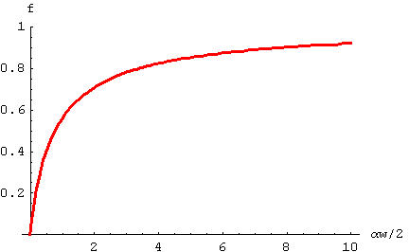
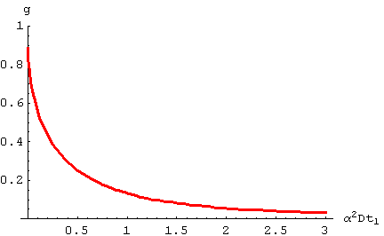
3D expansion: finite absorption α
Center of Gaussian beam, spot size w
Kernel for αw/2=1

Slide 32
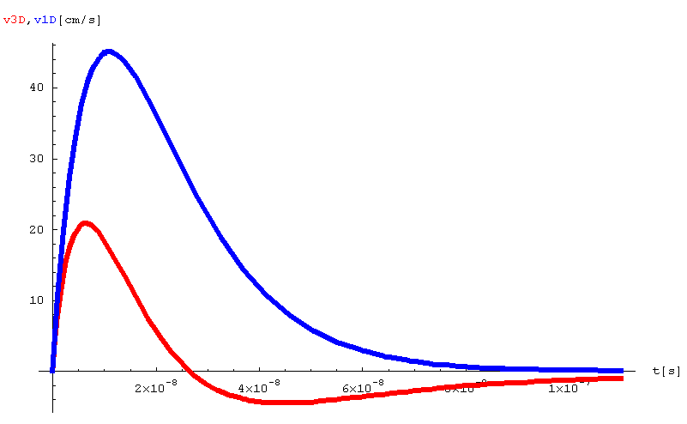
Example: Si, “Nd-YAG²”, αw/2=1, enhancement M=1
φ=1 J/cm², τ_{FWHM}=27 ns A=0.5, α=2×10⁴ cm⁻¹, w =1 µm
With surface absorption αw>>1
And small spot w²<< Dτ
αw↓

Slide 33
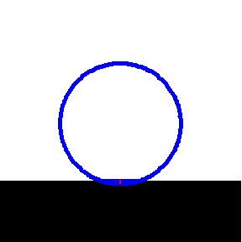
1D+3D expansion
1D and 3D superimpose
3D is transient and faster
epicentral 3D (small contact area)
3 regimes still valid

Slide 34
Dry Cleaning Threshold with Focusing and 3D expansion
3-30 threshold decrease
weak effect for small r
no flattening of φ_{cl}(r)
stronger 3D effects for large r, but:
T smaller due to low φ_{cl}
Caustics, dipoles - holds for non spherical particles
dipole
geometrical
1D expansion

Slide 35
Comparison with the experiment
SiO₂/Si, n=1.5
λ=248 nm
τ=27 ns
1D too small
3D OK
wrong slope:
local ablation
Schrems, Bäuerle et al. 2002

Slide 36
Ablative cleaning thresholds
Based on the “evaporation” temperature reached for:
Substrate
Particle
Liquid
Requires solution of:
Optical problem
Thermal problem
Notes:
Liquid if present

Slide 37
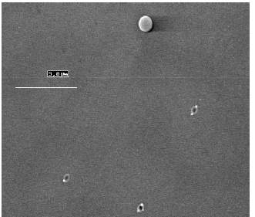
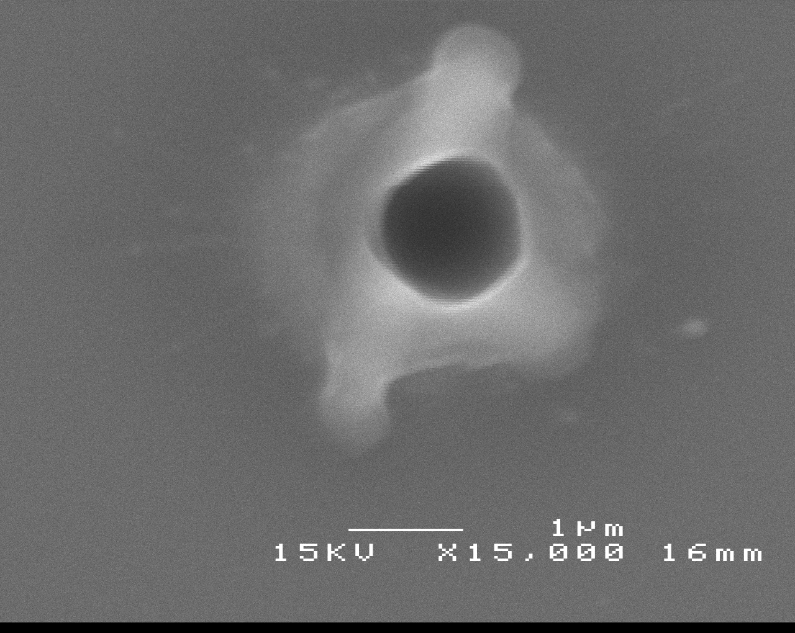
Damage – common in DLC
Different materials, pulse lengths, wavelength
SiO₂/Si, 1500 nm,
φ = 500 mJ/cm² ≈ φ_{cl}
λ=1064 nm, 6 ns
PS/Si, 800 nm, φ ~25 mJ/cm²
λ=800 nm, 30 ps
Mosbacher, Münzer et. al., Appl. Phys. A, 2001
Schrems, PhD thesis, Linz, 2002

Slide 38
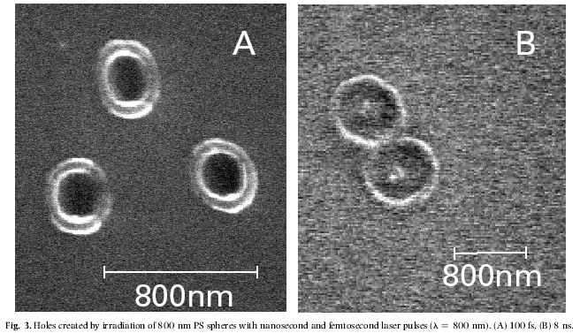
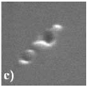
Irregularly
shaped particles:
fs holes better localized
800 nm
100 fs
8 ns
150 fs
PS/Si, 800nm, φ ~25 mJ/cm²
λ=800 nm
Al₂O₃/Si, 400 nm
λ=800 nm
Münzer, Mosbacher, et. al, Proc. SPIE, 2002
Leiderer, Boneberg, et al, Proc. SPIE, 2000

Slide 39
Focusing of sagittal rays ⇒ central caustic line (here in Mie calculations*)
Spherical particle
*Program by Wang, Luk’yanchuk, DSI Singapore

Slide 40
Intensity under a SiO₂ particle r = z =3.1 µm n=1.4, λ=248 nm. Mie parameter kr=78.54.
Central caustic line*
I_{c}~kr, w_{c}~ λ/5, ΔP/P~(kr)⁻¹
Caustic cone*
I_{co}~(kr)^{1/3}, w_{co}~λ^{2/3}r^{1/3}, ΔP/P~(kr)^{-1/3}
stable
Geometrical region
I_{g}~C(n), w_{g}~r, ΔP/P~1
Shadow
What determines T_{max} depends on pulse duration τ
*based on: Kravtsov, Orlov
Caustics, catastrophes and wave fields, 1998

Slide 41
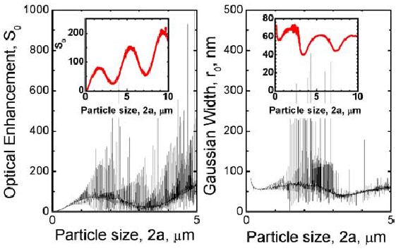
Intensity under the particle: Comparison with Mie results
Central intensity
I_{c} /I₀ ∝ r/λ
spot w_{c}~ λ/5
Mie resonances
(smeared out by imperfections)
Luk’yanchuk, Arnold, Huang, Wang, Hong., Appl. Phys. A, 2003
Notes:
Mie resonances smeared out by size distribution, shape changes, defects, absorption

Slide 42
Heating of particle
absorption
heat exchange with the substrate
“Transparent” particles
Very large particles α_{p}r>>1

Slide 43
Local 3D effects*
Intensity
Temperature
3D thermal expansion
Local ablation ~1.5T_{b},
momentum transfer
Dynamics of particle
Ablative
cleaning threshold
Thermal expansion
cleaning threshold
*Luk’yanchuk, Arnold, et al, Appl. Phys. A, 2003
Notes:
Particle substrate heat exchange is difficult, especially if we take into account that contact radius changes, etc.

Slide 44
Feasibility of ablative cleaning of particles
Conditions for the pressure p
Force criterion: pS>F_{adhesion}
Energy criterion pV>E_{adhesion}
Actual pressures higher (lateral expansion, losses)
Such pressures are attainable within narrow interval of T_{max}~1.5 T_{b}
Notes:
Liquid if present

Slide 45
Focusing: intensity and temperature
ns pulses, r>3λ:
I_{max} due to caustic
T_{max} due to geom.
(larger power)

Slide 46
Comparison with the experiment SiO₂/Si, ablative mechanism
- KrF, λ=248 nm, Vacuum*
τ=27 ns, A=0.39, l_{α}=6 nm, l_{T}=0.8 µm, n_{p}=1.5
Rescaled to Mie
3D calculations
Thermal expansion - wrong
Ablation-correct slope
Discrepancies:
Substrate influence
Parameters (T-dep., particles stoichiometry)
*Schrems, Mühlberger, et. al, 2002

Slide 47
Nd-YAG², λ=532 nm, Vacuum*
τ=8 ns, A=0.63, l_{α}=0.1 µm, l_{T}=0.45 µm
τ, l_{T} , l_{α}, r/λ , A change →
3D part different
Ablation - correct slope
*Bertsch, Mosbacher, et. al, 2002

Slide 48
Nd-YAG, λ=1064 nm, Vacuum*
τ=8 ns, A=0.7, l_{α}=17 µm, l_{T}=0.45 µm
Strong α(T)→
Large uncertainties, but
Ablation-correct slope
*Schrems, Bäuerle et al. 2003

Slide 49
Steam laser cleaning (SLC)

Slide 50
Cleaning in vapor atmosphere
Steam laser cleaning:
Explosive evaporation of thin liquid layer
Removes small particles, but:
poor reproducibility
Spin-on, film inhomogeneities
film unstable - evaporates, difficult to control,
synchronization with the laser pulse
Contaminates all surface
Kelvin
Radius R_{K}
Use capillary condensation
occurs below 100% relative humidity (RH)
stable liquid meniscus
liquid is only where it is needed

Slide 51
Kelvin Radius R_{K}
Decrease of evaporation energy per molecule due to curvature K
Saturated pressure over concave surface=ambient pressure p_{s}(K)=p ≡RH× p_{s}(0)
With relative humidity RH<1 curvature K is negative (concave meniscus) ⇒requires more than 1 surface
Similar to critical nucleus – extremum of free energy
For “void” capillary geometry meniscus is stable for condensation/evaporation

Slide 52
Capillary condensation
Liquid volume (wetting)
r
Liquid-particle surface
V_{l}
S₁
R_{K}
Capillary adhesion force
Independent on RH
Meniscus is stable. Kelvin radius:
σ - surface tension, µ - molar weight
Notes:
Note linear dependence on r

Slide 53
Experimental Setup
hygrometer
KrF laser
pulse
thermometer
entrance window
barometer
valve
valve
cooling
trap
reaction
chamber
target
93% ≤ RH ≤ 97%
25°C ≤ T ≤ 28,5°C
31mbar ≤ p ≤ 35mbar
distilled water
pump

Slide 54
KrF, λ=248 nm, RH vs Vacuum*
τ=27 ns, n_{p}=1.5, RH ≈0.95
With RH:
Larger particles φ_{cl}~const
Smaller particles φ_{cl}↓
T_{clean} gradually decreases
Why?
holes with large particles remain
*Schrems, Bäuerle et al, 2003

Slide 55
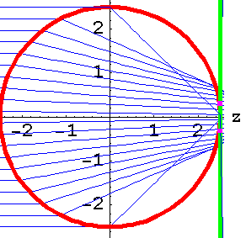
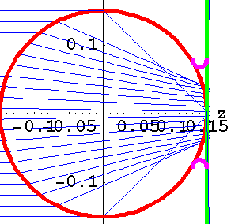
Water meniscus drawn in scale
n=1.4, RH=0.95
Kelvin radius R_{K}=10 nm
Size r= 2.5 µm
V_{water}>V_{ablated material} for smaller r
turnover at:
Size r= 0.15 µm
Note that:
Surface tension disappears near T_{c l}
water in the interstice
decreases adhesion ~10 times
Notes:
One can think of a tricky mechanism: Water a) increases adhesion by adds capillary force b) decreases adhesion as such by decreasing work of adhesion by polar molecules. When everything is cold, adhesion is increased, via capillary. But as we heat near critical temperature, capillary contribution disappears due to vanishing surface tension and we are left with pure decrease of adhesion.

Slide 56
Conclusions for cleaning with RH≈0.95
Large particles (2r=5000, 3280 nm)
Ablation of substrate is dominant ⇒
φ_{cl} ≈const(RH)
Small particles (300 nm – 800 nm)
Removed more efficiently in RH - large contribution of explosively vaporized water

Slide 57
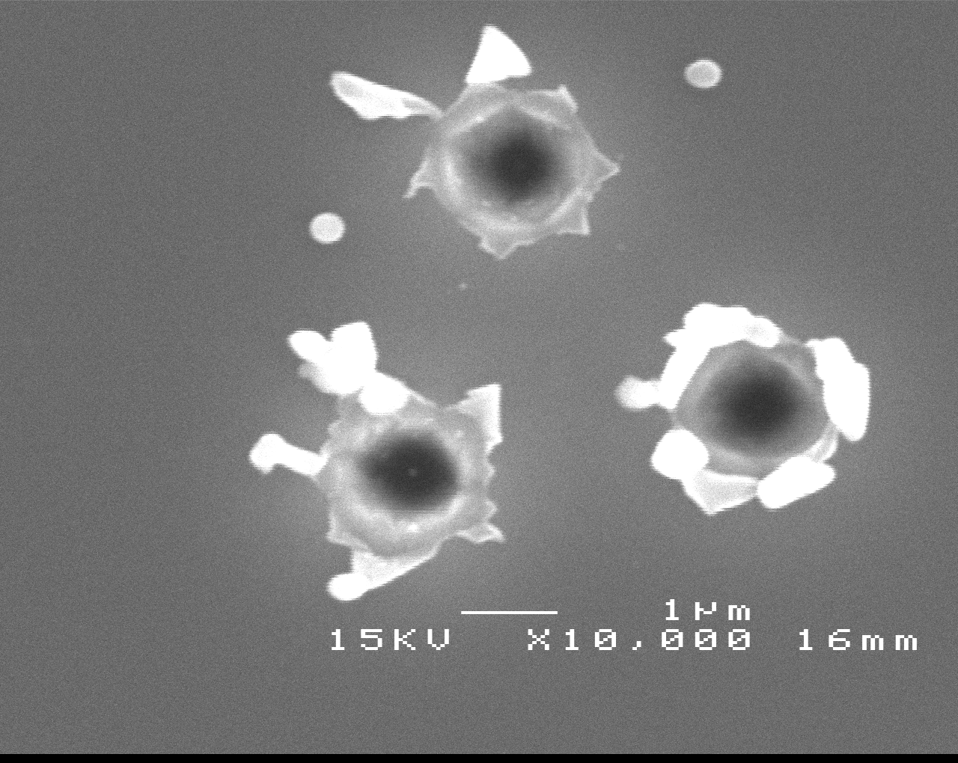
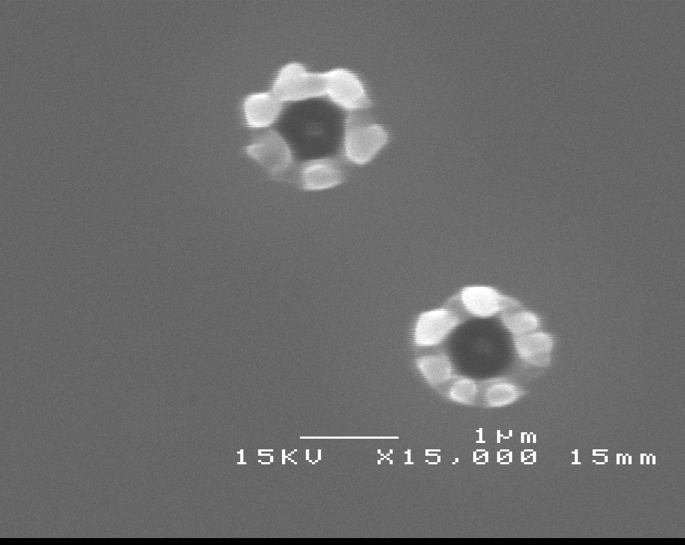
KrF, λ=248 nm, 27 ns
RH ≈ 0.95
Large particles
still produce holes*
2r=5 µm SiO₂
Particles on Si, φ = 383 mJ/cm²
2r =3.28 µm SiO₂
Particles on Si, φ = 350 mJ/cm²
*G. Schrems, Ph.D. thesis, Linz (2003)

Slide 58
Let us draw it in scale
RH=0.95, Kelvin radius R_{K}=10 nm
n=1.4
There is a difference between RH=0.95 and 0.99
r= 2.5 µm
r= 150 nm
RH=0.99 Kelvin radius R_{K}=50 nm
Note that:
Surface tension disappears near T_{c l}
water molecules in the interstice may
decrease adhesion by a factor of ~100
⇒Heating up to below T_{c l} may help
r= 50 nm
r= 150 nm
Notes:
One can think of a tricky mechanism: Water a) increases adhesion by adds capillary force b) decreases adhesion as such by decreasing work of adhesion by polar molecules. When everything is cold, adhesion is increased, via capillary. But as we heat near critical temperature, capillary contribution disappears due to vanishing surface tension and we are left with pure decrease of adhesion.

Slide 59

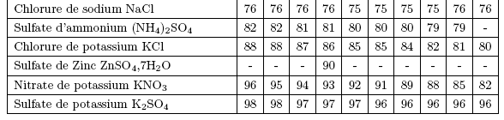
How to achieve stable high RH~1 : desired experimental setup
saturated salt, glycerol or sulfuric acid solutions*
hygrometer
laser
pulse
thermometer
entrance
window
barometer
valve
Also*: At 20 °C:
Pb(NO₃)₂ RH=98
CuSO₄.5H₂O RH=98
H₂SO₄:ρ 1.05→1, RH 97.5→1
thermostatic
reaction chamber
target
saturated salt, glycerol
or sulfuric acid solutions
*From: F. Restagno, PhD thesis, Lyon, 2000
R. C. Weast. CRC Handbook of Chemstry and Physics

Slide 60
Cleaning with laser-excited SAW (surface acoustic waves)

Slide 61
Cleaning with laser-excited
1D SAW (surface acoustic waves)
Advances in theory
SAW cleaning outside the beam
was demonstrated
Field enhancement →
Local ablation →
Damage
Difficult to modulate
No light – no damage
Interference→1D→
GHZ possible
Recovered
Resonant laser cleaning (RLC) idea

Slide 62
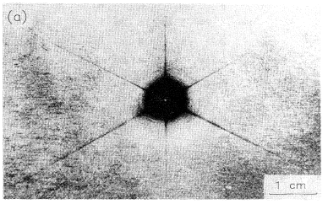
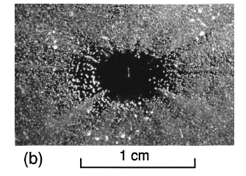
SAW cleaning with focused pulses*
1-2 µm Al₂O₃ on (111) Si, in air
Nd:YAG-1.06 µm, 10 ns,10 pulses
1-10 µm Al₂O₃ on (100) Si, in air
N₂-337 nm, 10 ns, 50 pulses
SAW wavelength is determined by the spot size ~ 15 µm
SAW is 2D and decays fast
SAW has 1-2 oscillations only
Cleaning of the particles outside of irradiated area, enhanced along the lines where SAW is stronger
*A. A. Kolomenskii, H. A. Schuessler, V. G. Mikhalevich, and A. A. Maznev, J. Appl. Phys., 84(5) 2404 (1998)
A. A. Kolomenskii, A. A. Maznev, Phys. Rev. B., 48(19) 14502 (1993)

Slide 63
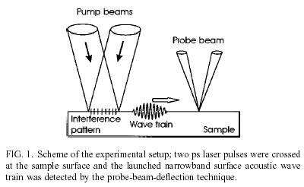
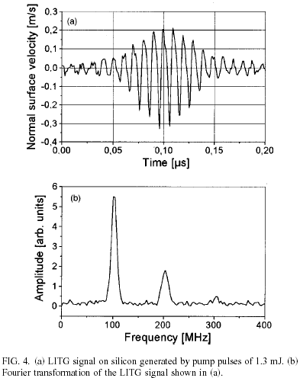
SAWs excited with
ps-pulse interference*
180 ps, THG Nd:YAG (335 nm), Si
100 MHz frequency θ=0.8° easily varied up to 1-10 GHz**
Many oscillations - resonance
1D propagation out of the beam area
No light – no damage
Non-linear effects, larger acceleration
Breakdown in air, universality
*A. Frass, A. Lomonosov, P. Hess, V. Gusev, J. Appl. Phys., 87(7) 3505 (2000)
**R. M. Slayton, K. A. Nelson, A. A. Maznev, J. Appl. Phys., 90(9) 4392 (2001)

Slide 64
Advantages of 1D SAW excited by laser light interference for cleaning
SAW are 1D. No fast decay, propagate out of the beam area.
No light is present in the majority of area covered by SAW ⇒No local field enhancement-damage.
SAW have many oscillations, suitable for testing of RLC
Frequency is determined by the periodicity of interference. v_{SAW}~v_{sound}/λ_{light}~1-10 GHz - suitable for resonant laser cleaning (RLC).
Frequency easily varied via angle of interfering beams. Indispensable for testing and application of RLC.
Smaller overall thermal load on the substrate.
Non-linearity makes fronts steeper, increase accelerations.
Can be excited via breakdown in the air. Material independent, suitable for structured substrates, (industry).

Slide 65
Influence of storage time

Slide 66
Influence of storage time*
Cleaning threshold strongly depends on storage time,
especially for larger particles
*G. Schrems, M. P. Delamare, et al. 2002

Slide 67
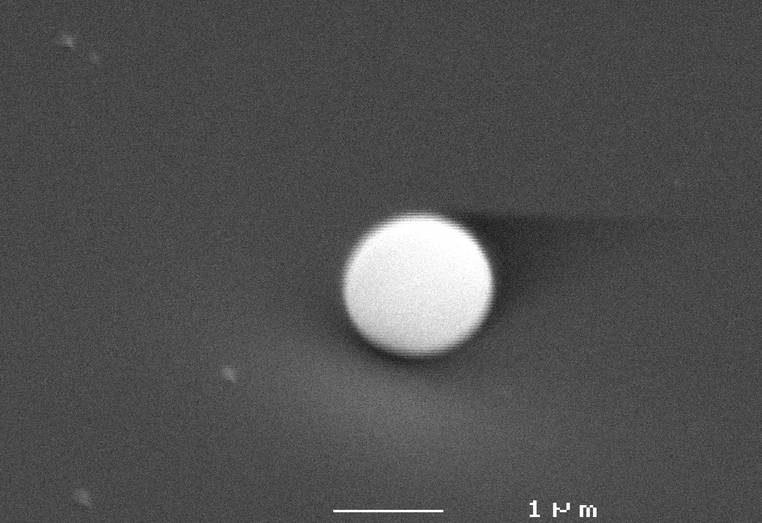
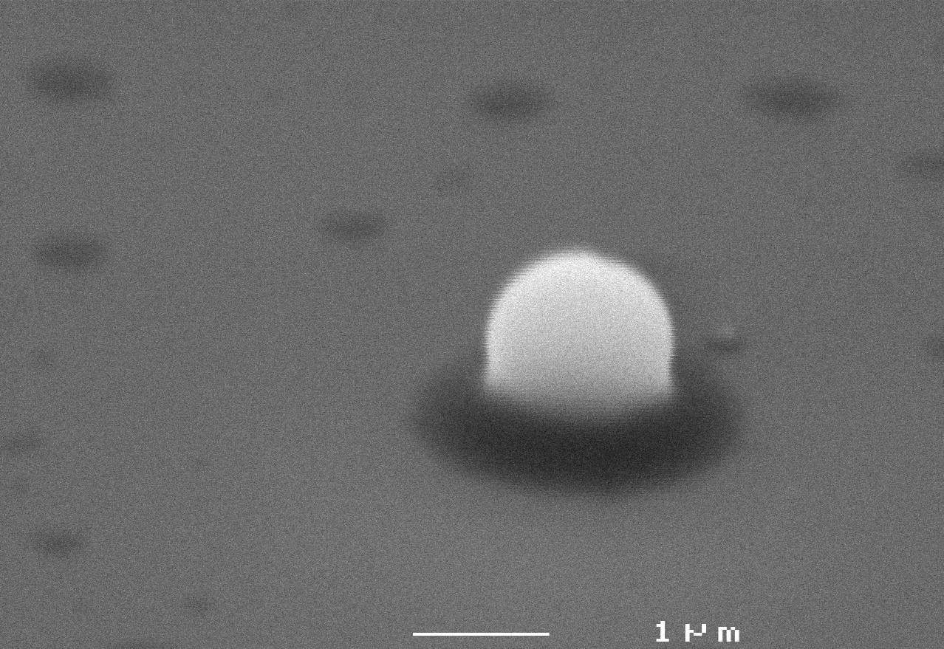
Visible deformation, larger contact area, therefore stronger adhesion
SiO₂/Si, 1500 nm
17 h
1350 h
Reasons: possible formation of covalent bonds:
Hydroxyl groups – hydrogen bonds – water loss – formation of covalent bonds –Si–O–Si–
stronger adhesion – stronger deformation – larger contact area – even stronger adhesion
Possible plastic deformation
Additional oxidation

Slide 68
Storage time: threshold dependence
1500 nm particles: threshold doubles
Small times are necessary for reproducible experiments

