Slide 1
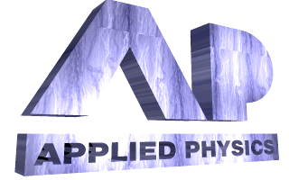

ABLATIVE THRESHOLDS IN LASER CLEANING
OF SUBSTRATES FROM PARTICULATES
N. Arnold, G. Schrems, D. Bäuerle
Angewandte Physik, Johannes - Kepler - Universität
A-4040, Linz, Austria

Slide 2
Summary:
Thermal expansion models of dry laser cleaning (DLC)
Holes under the particles
Field enhancement overview
Local ablation thresholds
Principal limitations for damage-free DLC
Influence of humidity

Slide 3
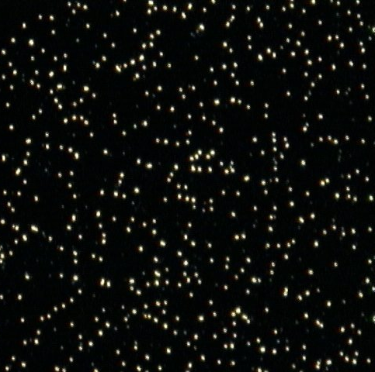
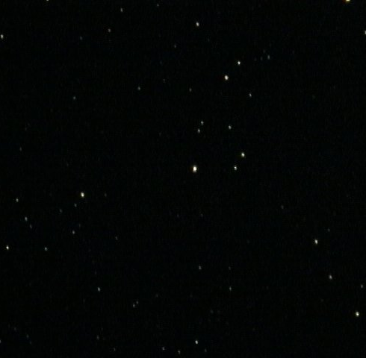
Principle of dry laser cleaning¹
short
laser
pulse
Before
After
Fast thermal expansion
¹Zapka, Tam, Appl. Phys. Lett., 91
Notes:
Real particles are non-spherical, but spherical particles are often used for controllable and reproducible experiments, that allow quantification.

Slide 4
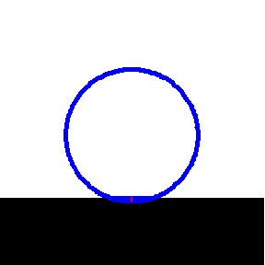
1D+3D expansion
Removal conditions:
  heavy particles: elastic energy E_{elastic}>E_{adhesion}
  small particles: force of inertia F_{cleaning}>F_{adhesion}

Slide 5
Thermal expansion: theory and experiment
SiO₂/Si, n=1.5
λ=248 nm
τ=27 ns
1D too weak
3D OK*
wrong slope:
local ablation
Schrems, Mühlberger, et. al, Proc. SPIE, (2002)
* Laser Cleaning, Luk'yanchuk ed., (2002)

Slide 6
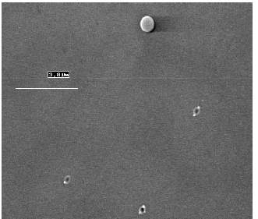
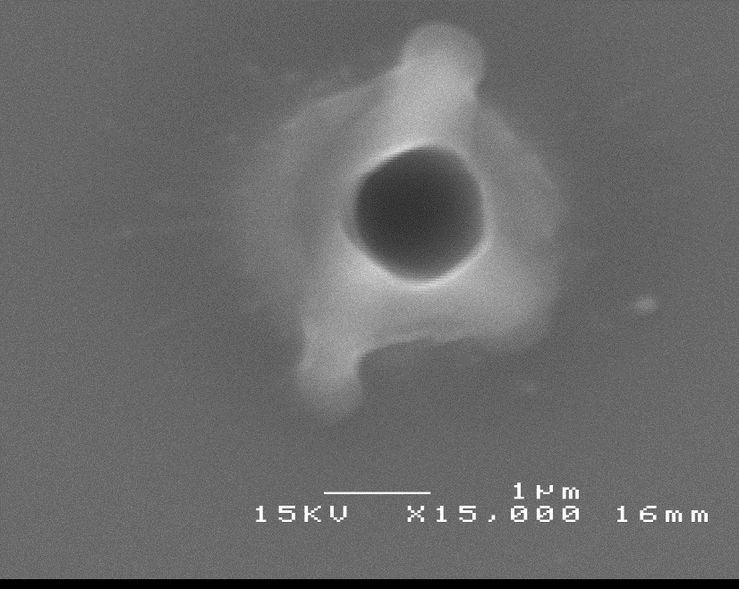
Damage – common in DLC
Different materials, pulse lengths, wavelength
SiO₂/Si, 1500 nm,
φ = 500 mJ/cm² ≈ φ_{cl}
λ=1064 nm, 6 ns
PS/Si, 800 nm, φ ~25 mJ/cm²
λ=800 nm, 30 ps
Mosbacher, Münzer et. al., Appl. Phys. A, 2001
Schrems, PhD thesis, Linz, 2002

Slide 7
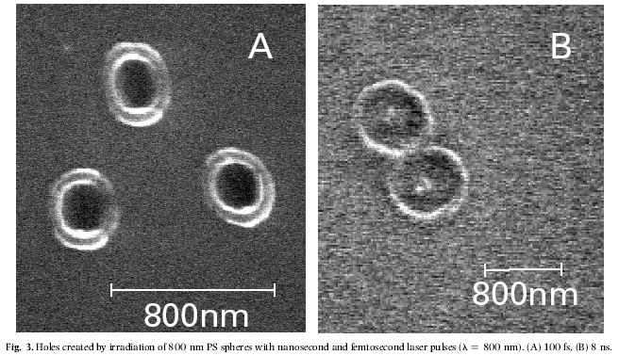
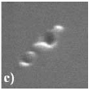
Irregularly
shaped particles:
fs holes better localized
800 nm
100 fs
8 ns
150 fs
PS/Si, 800nm, φ ~25 mJ/cm²
λ=800 nm
Al₂O₃/Si, 400 nm
λ=800 nm
Münzer, Mosbacher, et. al, Proc. SPIE, 2002
Leiderer, Boneberg, et al, Proc. SPIE, 2000

Slide 8
Optical problem:
Small particles – near field dipole
Large transparent particles –geometrical + diffraction optics, caustics, Mie calculations
Arrays of large particles not in contact with the substrate can be used for different types of parallel surface processing (ablation, deposition, etching, modification)*
*Denk, Piglmayer, Bäuerle, Appl. Phys. A, Appl. Phys. Lett, 2002, 2003

Slide 9
Small particle – near field dipole
E_{x}
laser
r=0.2λ; n=1.5
spot w_{d}∝ r
additional 3D intensity I_{d}/I₀ ∝ r²
Holds also for non-spherical particles
3D

Slide 10
Large particle -- geometrical optics
r>>λ; n=1.5
Transparent particle
I_{g} near the surface
Caustic cone
spot w_{g}∝ r
intensity I_{g}/I₀ - independent on r

Slide 11
Focusing of sagittal rays ⇒ central caustic line (here in Mie calculations*)
Spherical particle
*Program by Wang, Luk’yanchuk, DSI Singapore

Slide 12
Intensity under a SiO₂ particle r = z =3.1 µm n=1.4, λ=248 nm. Mie parameter kr=78.54.
Central caustic line*
I_{c}~kr, w_{c}~ λ/5, ΔP/P~(kr)⁻¹
Caustic cone*
I_{co}~(kr)^{1/3}, w_{co}~λ^{2/3}r^{1/3}, ΔP/P~(kr)^{-1/3}
stable
Geometrical region
I_{g}~C(n), w_{g}~r, ΔP/P~1
Shadow
What determines T_{max} depends on pulse duration τ
*based on: Kravtsov, Orlov
Caustics, catastrophes and wave fields, 1998

Slide 13
Local 3D effects*
Intensity
Temperature
3D thermal expansion
Local ablation ~1.5T_{b},
momentum transfer
Dynamics of particle
Ablative
cleaning threshold
Thermal expansion
cleaning threshold
*Luk’yanchuk, Arnold, et al, Appl. Phys. A, 2003
Notes:
Particle substrate heat exchange is difficult, especially if we take into account that contact radius changes, etc.

Slide 14
Feasibility of ablative cleaning of particles
Conditions for the pressure p
Force criterion: pS>F_{adhesion}
Energy criterion pV>E_{adhesion}
Actual pressures higher (lateral expansion, losses)
Such pressures are attainable within narrow interval of T_{max}~1.5 T_{b}
Notes:
Liquid if present

Slide 15
Focusing: intensity and temperature
ns pulses, r>3λ:
I_{max} due to caustic
T_{max} due to geom.
(larger power)

Slide 16
Comparison with the experiment SiO₂/Si, ablative mechanism
- KrF, λ=248 nm, Vacuum*
τ=27 ns, A=0.39, l_{α}=6 nm, l_{T}=0.8 µm, n_{p}=1.5
Rescaled to Mie
3D calculations
Thermal expansion - wrong
Ablation-correct slope
Discrepancies:
Substrate influence
Parameters (T-dep., particles stoichiometry)
*Schrems, Mühlberger, et. al, 2002

Slide 17
Nd-YAG², λ=532 nm, Vacuum*
τ=8 ns, A=0.63, l_{α}=0.1 µm, l_{T}=0.45 µm
τ, l_{T} , l_{α}, r/λ , A change →
3D part different
Ablation - correct slope
*Bertsch, Mosbacher, et. al, 2002

Slide 18
Nd-YAG, λ=1064 nm, Vacuum*
τ=8 ns, A=0.7, l_{α}=17 µm, l_{T}=0.45 µm
Strong α(T)→
Large uncertainties, but
Ablation-correct slope
*Schrems, Bäuerle et al. 2003

Slide 19
How to avoid local damage

Slide 20
Optimal absorption length and pulse duration
Larger substrate l_{α} is better for damage-free cleaning
Why?
expansion l∝ Tdz →
Larger with the same surface temperature T_{s}
T_{s}<T_{m}
T(z)

Slide 21
Small particles are interesting
They weakly disturb the local field (small dipole moment)⇒1D
They are removed in the force regime ml/τ ²>F_{adhesion}
Maximum expansion till melting l<β₁T_{m}(l_{α}+l_{T})
←Sizes that can be removed
ϕ - work of adhesion
β - thermal expansion coefficient

Slide 22
Excimer
l_{α}=10 nm
in µm, ns:
Q-switch
l_{α}=100 µm
τ =100 ps
l_{α}=1 µm
Si:
l_{α}(193,248,308)≈5-10 nm
l_{α}(1.06) ≈ 200 µm→50 nm
l_{α}(2.94) ≈ 500 cm→30 µm (depending on doping and T)
l_{α}(10.6) ≈ 1000 µm→100 nm
Er or other IR with τ ~100 ps

Slide 23

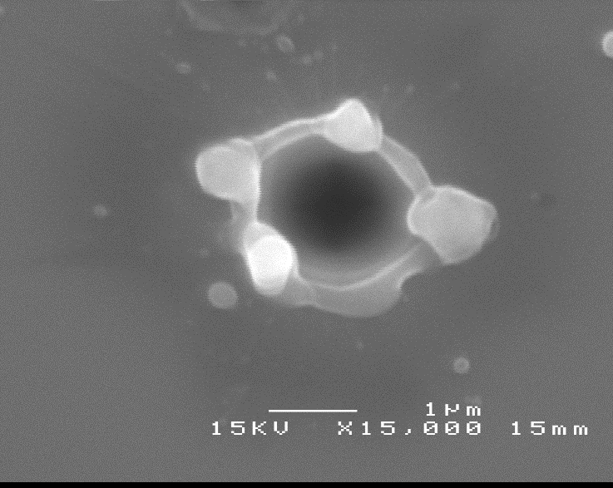
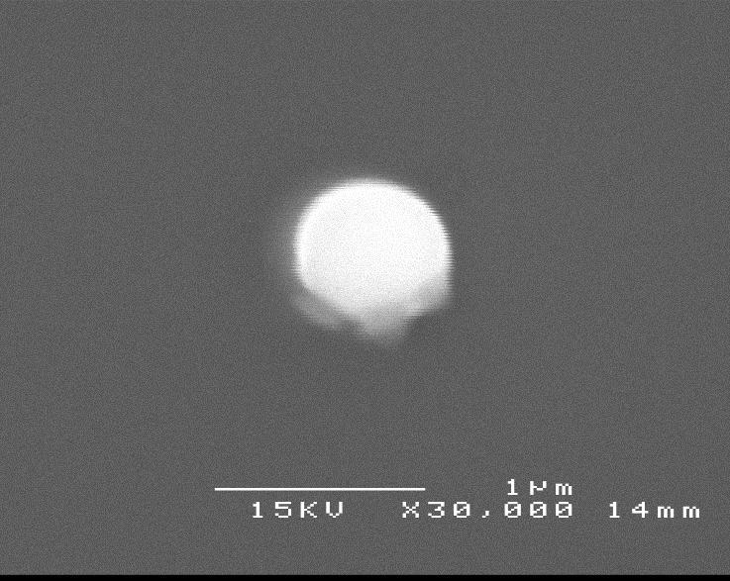
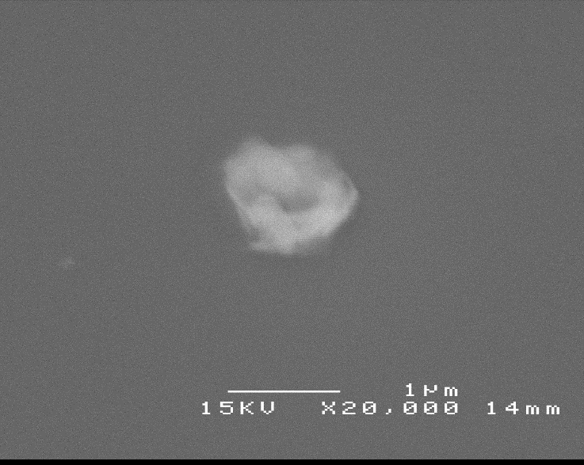
Nd-YAG 1064 SiO₂/Si Experimental results
Schrems, Ph.D thesis, Linz, 2003
d =1500 nm, φ = 500 mJ/cm² ≈ φ_{cl}
d =3280 nm, φ = 280 mJ/cm² ≈ φ_{cl}
d = 990 nm, φ = 675 mJ/cm² ≈ φ_{cl}
d=990 nm, φ = 675 mJ/cm² ≈ φ_{cl}
Notes:
Unfortunately, upon detailed examination one finds either holes in the substrate or debris from the exploded particle.

Slide 24
Nd-YAG 1064 nm: Results and Conclusions
φ_{cl} = φ_{hole formation} for 2r > 1500 nm
990 nm SiO₂ particles melt around φ_{cl}
Particles absorb at 1064 nm (probably SiO_{x} → color centers).
Nd-YAG is NOT suitable for cleaning of colloid SiO₂ particles ⇒other particles/wavelength should be considered

Slide 25
Cleaning in vapor atmosphere
Steam laser cleaning:
Explosive evaporation of thin liquid layer
Removes small particles, but:
poor reproducibility
Spin-on, film inhomogeneities
film unstable - evaporates, difficult to control,
synchronization with the laser pulse
Contaminates all surface
Kelvin
Radius R_{K}
Use capillary condensation
occurs below 100% relative humidity (RH)
stable liquid meniscus
liquid is only where it is needed

Slide 26
Capillary condensation
Liquid volume (wetting)
r
Liquid-particle surface
V_{l}
S_{l}
R_{K}
Capillary adhesion force
Independent on RH
Meniscus is stable. Kelvin radius:
σ - surface tension, µ - molar weight
Notes:
Note linear dependence on r

Slide 27
Experimental Setup
hygrometer
KrF laser
pulse
thermometer
entrance window
barometer
valve
valve
cooling
trap
reaction
chamber
target
93% ≤ RH ≤ 97%
25°C ≤ T ≤ 28,5°C
31mbar ≤ p ≤ 35mbar
distilled water
pump

Slide 28
KrF, λ=248 nm, RH vs Vacuum*
τ=27 ns, n_{p}=1.5, RH ≈0.95
With RH:
Larger particles φ_{cl}~const
Smaller particles φ_{cl}↓
T_{clean} gradually decreases
Why?
holes with large particles remain
*Schrems, Bäuerle et al, 2003

Slide 29
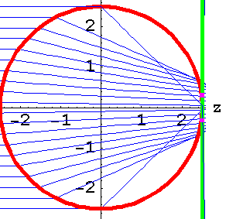
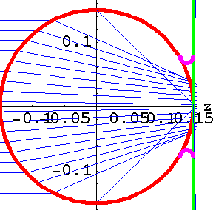
Water meniscus drawn in scale
n=1.4, RH=0.95
Kelvin radius R_{K}=10 nm
Size r= 2.5 µm
V_{water}>V_{ablated material} for smaller r
turnover at:
Size r= 0.15 µm
Notes:
One can think of a tricky mechanism: Water a) increases adhesion by adds capillary force b) decreases adhesion as such by decreasing work of adhesion by polar molecules. When everything is cold, adhesion is increased, via capillary. But as we heat near critical temperature, capillary contribution disappears due to vanishing surface tension and we are left with pure decrease of adhesion.

Slide 30
Conclusions for cleaning with RH≈0.95
Large particles (2r=5000, 3280 nm)
Ablation of substrate is dominant ⇒
φ_{cl} ≈const(RH)
Small particles (300 nm – 800 nm)
Removed more efficiently in RH - large contribution of explosively vaporized water

Slide 31
Conclusions
Overview of field enhancement by transparent spherical particles is presented
Model based on local ablation describes cleaning thresholds better than thermal expansion
Principal limitations for damage-free DLC are considered. For Si, substrate absorption weaker than that of excimer lasers is advantageous. Move to IR and sub-ns pulses is suggested
High RH improves cleaning of small particles, hinders that of average particles and has no effect on large ones. This is attributed to gradual contribution of capillary condensed water to ablative cleaning.

Slide 32
Acknowledgments
Linz
Prof. D. Bäuerle, Dr. M.P. Delamare, DI. G. Schrems, Dr. K. Piglmayer
Konstanz
Prof. P. Leiderer, DI. M. Mosbacher, Dr. H.-J. Münzer, DI. M. Olapinski
Singapore
Prof. B. Luk’yanchuk, Prof. M. Hong, Dr. Z. B. Wang
Sydney
Prof. D. Kane, Dr. S. Pleasants
Funding:
EU TMR Laser Cleaning, #ERBFMRXCT98 0188, coordinator Prof. R. Oltra, Dijon
Austrian Science Fund (FWF), P14700-TPH

